Slide 1
ProgramminG LANGUAGE

Slide 2
What is programming language
A programming language allows people to create programs that tell machines (computers) what to do

Slide 3
Levels of LANGUAGE
HIGH-LEVEL LANGUAGE
ASSEMBLY LANGUAGE
LOW-LEVEL LANGUAGE
MACHINE LANGUAGE

Slide 4
Types of programme
Imperative programming©
Object-oriented programming (c++)
Logic/declarative programming (prolog)
Functional/applicative programming (lisp)

Slide 5
HIGH LEVEL OF LANGUAGE
C
C++
JAVA
DEVELOPED BY BELL LABORATORIES IN THE EARLY 1970s.
OFTEN USED FOR SYSTEM PROGRAMS.
‘UNIX’ IS WRITTEN IN C
EXAMPLE OF C PROGRAME
IT IS C LANGUAGE WITH ADDITIONAL FRATURES
WIDELY USED FOR DEVELOPING SYSTEM AND APPLICATION SOFTWARE
GRAPHICAL USER INTERFACE CAN BE DEVELOPED EASILY WITH VISUAL PROGRAMMING TOOLS
AN OBJECT-ORIENTED LANGUAGE SIMILAR TO C++ THAT ELIMINATES LOTS OF C++ PROBLEMATIC FEATURES
ALLOWS A WEB PAGE DEVELOPER TO CREATE PROGRAMS FOR APPLICATIONS
OBJECTIVE OF JAVA DEVELOPERS IS THAT IT BE MACHINE,PLATFORM AND OPERATING SYSTEM INDEPENDENT

Slide 6
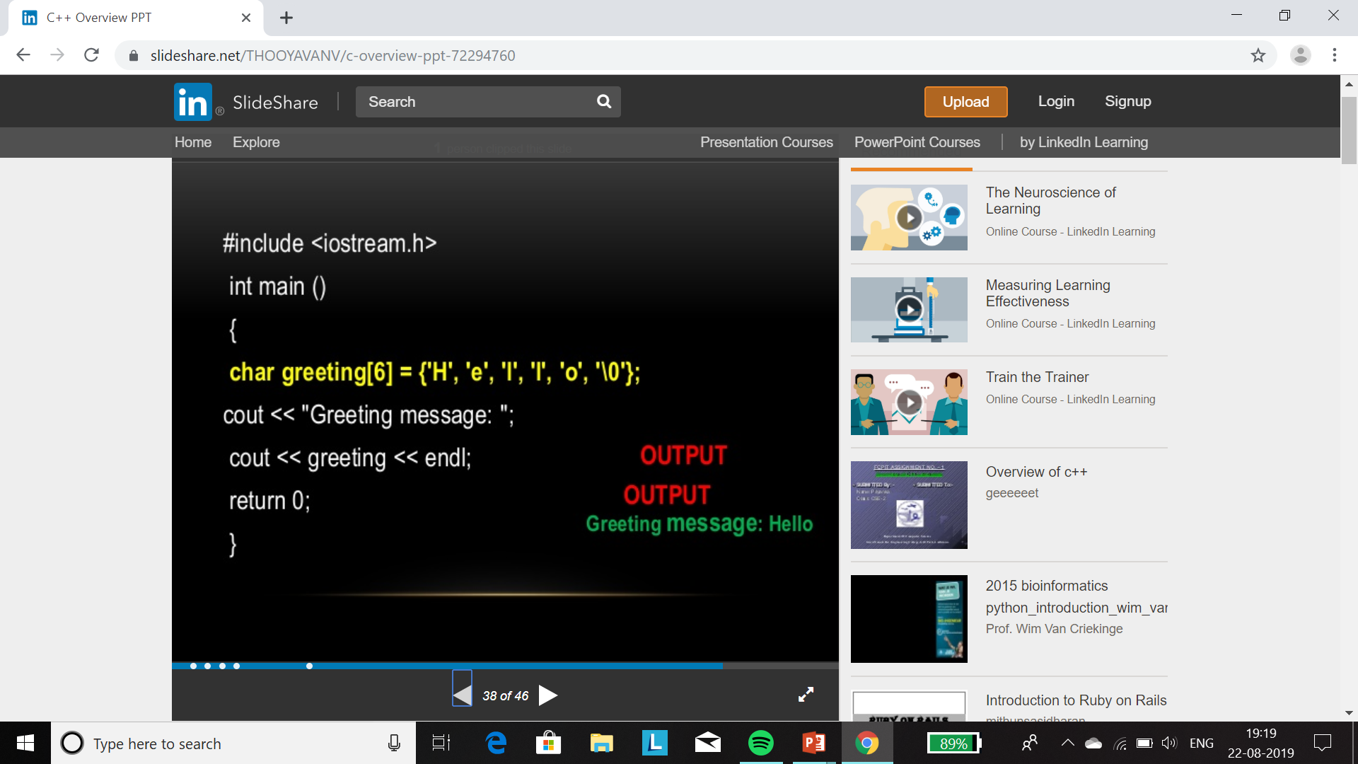
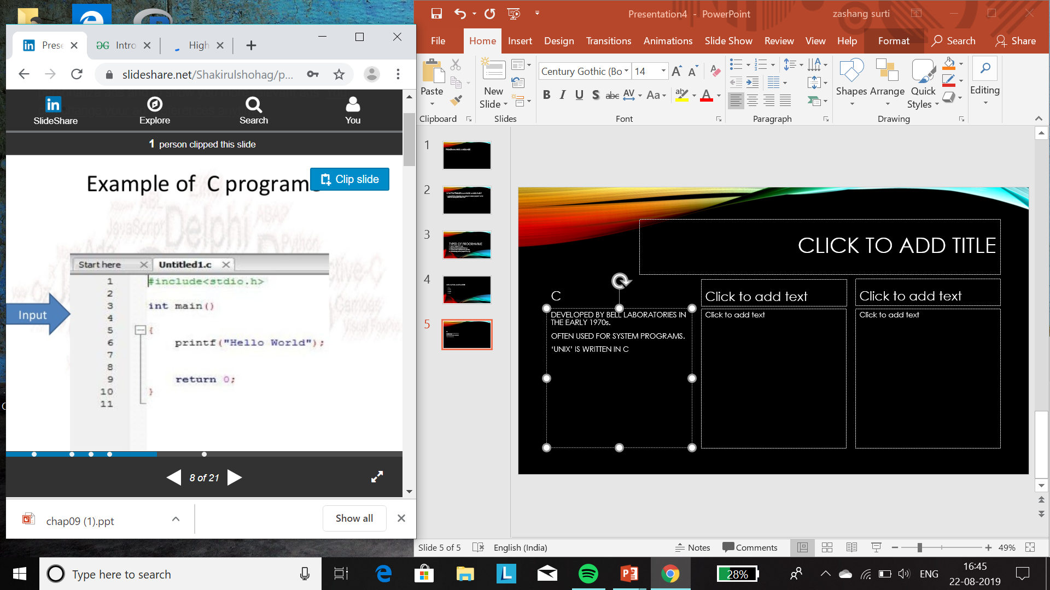
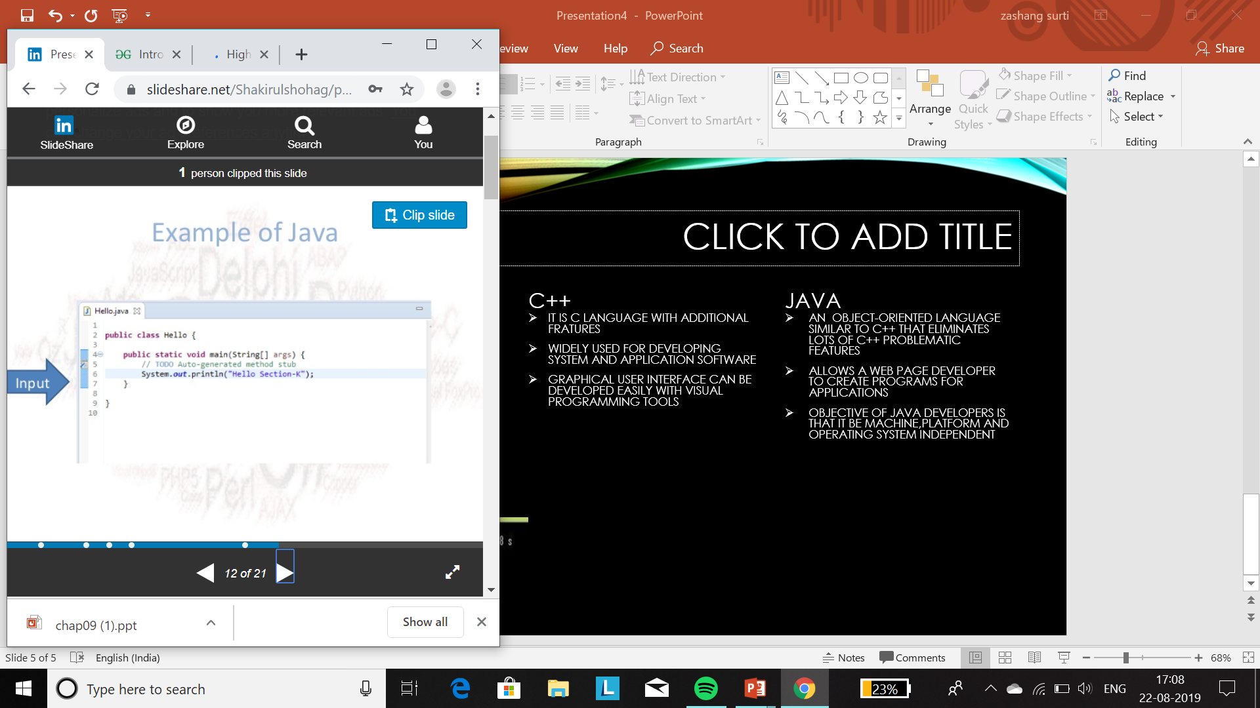
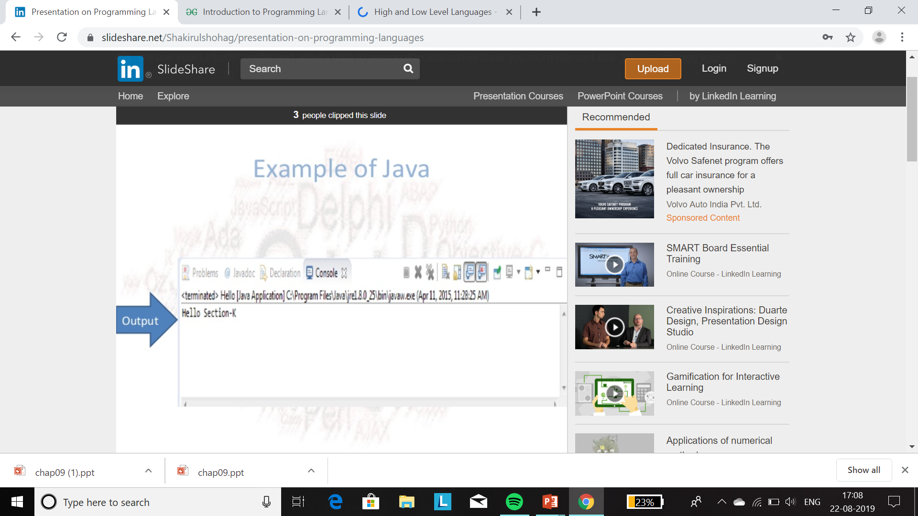
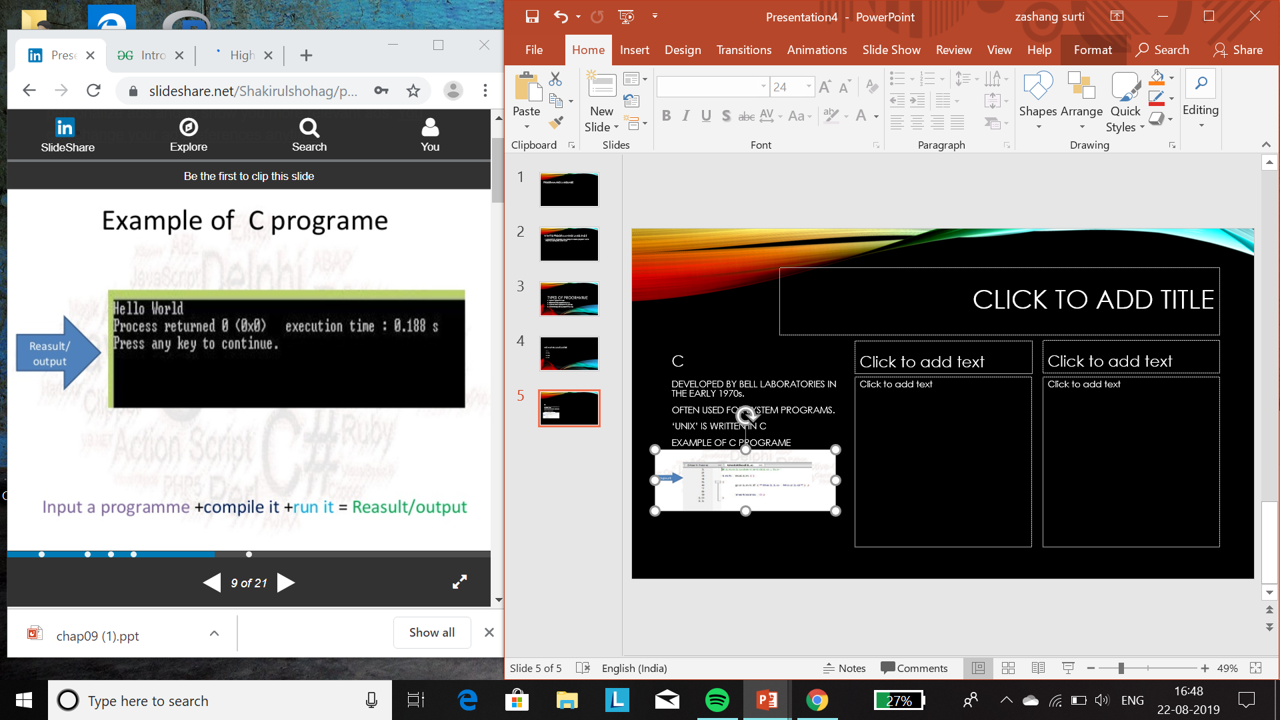
INPUT AND OUTPUT OF LANGUAGE
C
C++
JAVA
.
.
.

Slide 7
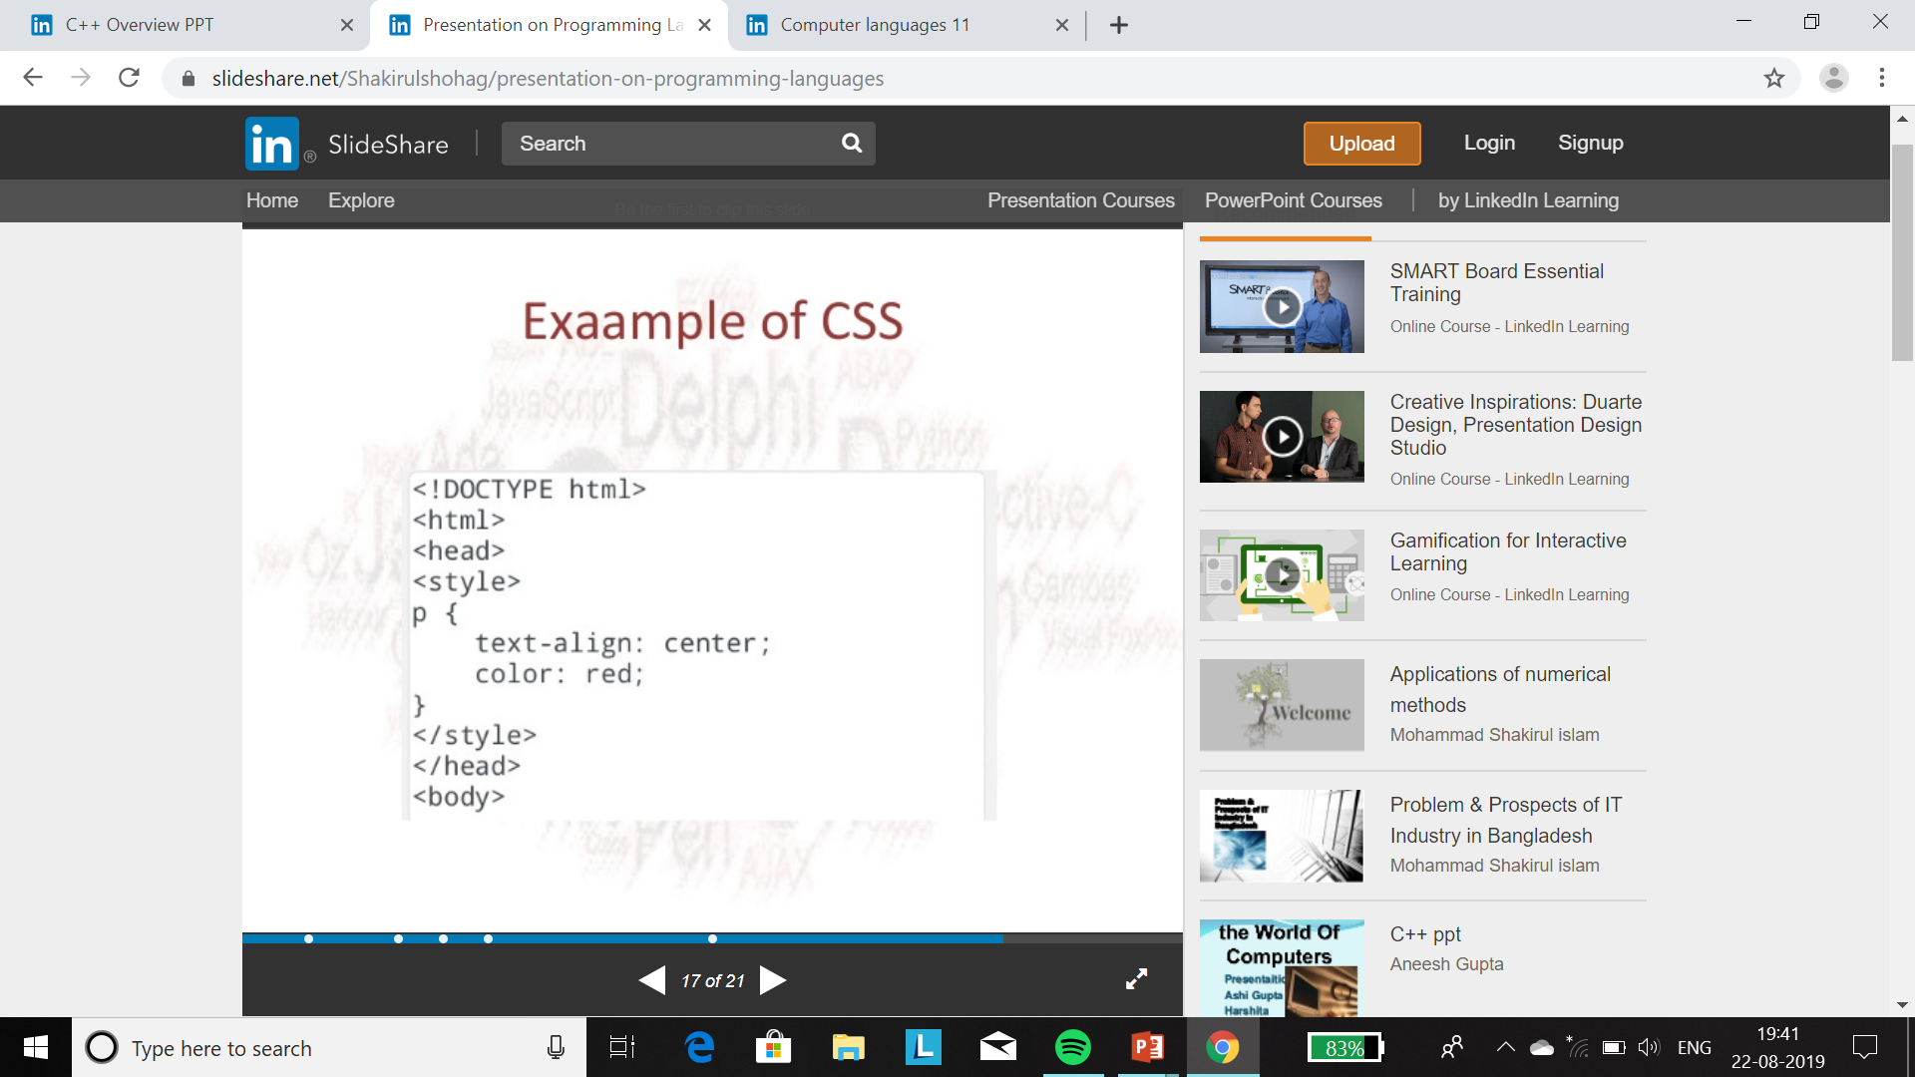
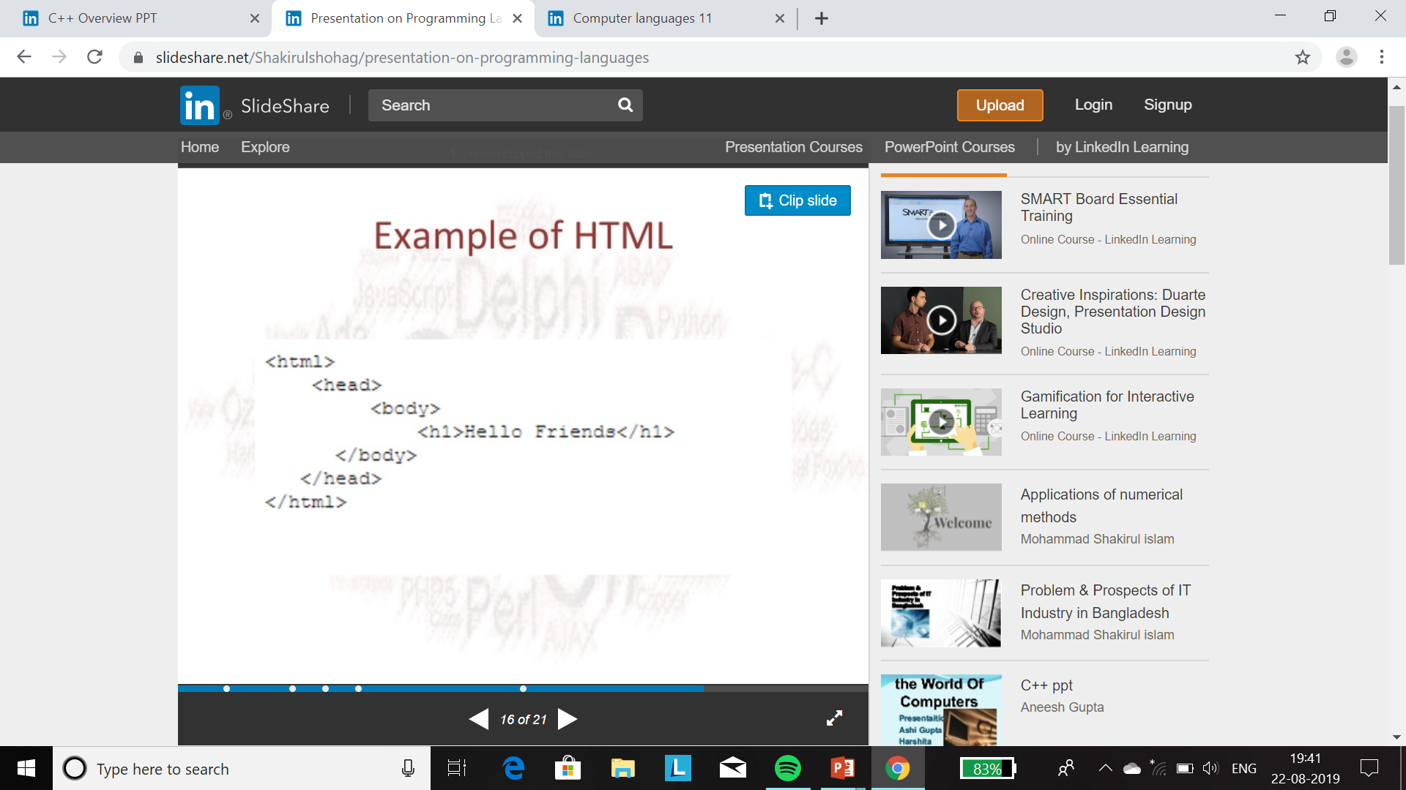
EXAMPLES OF CSS AND HTML
HTML
CSS

Slide 8
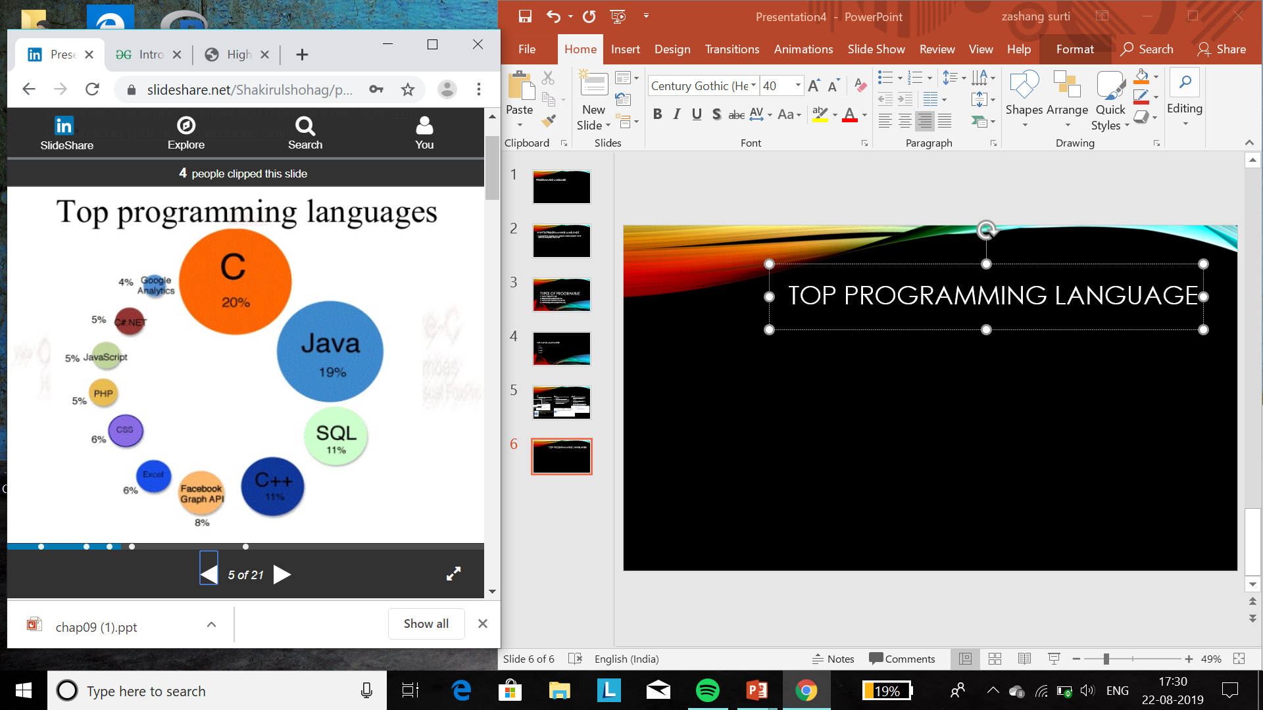
Top programming language

Slide 9
THANK YOU

